Slide 1


Inventory Management System Analysis using SQL
Presented by : Shamal Pradip Kumbhar
Notes:
Good Evening mam. Thankyou for giving me this opportunity to present my project. I’m Shamal Pradip Kumbhar, and today I’ll be presenting on Inventory Management System Analysis using SQL. This presentation will explore how structured data and SQL can help solve major inventory management challenges.

Slide 2

CONTENTS
Inventory Management System
Challenges in Inventory Management
Objectives for inventory Management
Data Schema used in this Project
Entity Relationship Diagram
SQL Concepts Applied
Inventory Management System Analysis
Conclusion and Strategy
Notes:
We’ll walk through the challenges in inventory management, our objectives, the data schema, SQL concepts used, analysis of the inventory system, and finally, strategies for improvement based on data-driven insights

Slide 3
01 Inventory Management System
Important in business
Track, manage, optimize
Minimizing cost and maximizing efficiency
Retail
FMCG
Healthcare
Logistics
E-commerce
Companies selling goods to consumers.
Fast-moving consumer goods like packaged foods.
Services related to medicine and well- being.
Transportation and storage of goods.
Buying and selling goods online.
Notes:
An Inventory Management System (IMS) is and important component of any business.
It helps businesses track, manage, and optimize their stock levels.
It ensures that the right amount of inventory is available at the right time, minimizing costs and maximizing efficiency.
Inventory management is critical in sectors like retail, FMCG, healthcare, logistics, and e-commerce. All these industries rely on accurate tracking and timely replenishment of stock to stay competitive and profitable.

Slide 4
02 Challenges in Inventory Management
Wastage
Stockouts
Loss of
sales
Profitable products
Delayed shipments
Unnecessary loss or destruction of products.
Running out of products and being unable to fulfill orders.
Reduced revenue due to inventory problems.
Identifying products that generate the most profit.
Shipments arriving later than expected.
Vendor performance
Excess inventory
Lack of insights
Unmonitored Expiry
Overstocking
Inadequate supplier service impacting inventory.
Absence of data- driven understanding of inventory.
Products expiring without being tracked or managed.
Having too much inventory, leading to storage costs.
Holding more stock than is needed.
Notes:
Despite its importance, inventory management faces many challenges—
Wastage or destruction of products,
unmonitored expiry which if not tracked will lead to product being expired without being sold and loss od revenue in the process,
stockouts make it unable to fulfill the order of customers,
overstocking leading to storage cost,
Loss of sales due to inventory problems,
poor vendor performance,
identifying profitable products,
excess of inventory leading to holding more stock than needed,
delayed shipments leading to stockouts and ultimately loss of customers, and most importantly
lack of insights
This challenges can be solved by setting objectives and analyzing them using SQL.

Slide 5



03 Objectives for Inventory Management System
SYSTEM
Good Inventory Management
Enable Forecasting
Improve Shipment
Use data to predict future inventory needs.
MANAGEMENT
Streamline the shipping and fulfillment process.
INVENTORY
From Chaos to Control
Optimize Inventory
GOOD
Analyze Sales
Reduce holding costs and improve efficiency.
Evaluate sales data to understand trends and profitability.
TO
Manage Suppliers
Establish and maintain strong supplier relationships.
Track Inventory Levels
WAY
Monitor and maintain accurate inventory counts.
Bad Inventory Management
Notes:
Our goals are
to track inventory levels for accurate count,
manage suppliers for strong supplier relationship,
analyze sales to understand trends and profitability,
optimize inventory to reduce holding cost which will improve efficiency,
along with this we also need to improve shipments for avoiding any stockouts,
and most importantly we need to use forecasting to plan inventory needs for the future demands.
All this objectives with SQL analysis will lead our inventory from a bad management to good management. Ultimately, we want to move from chaos to control.

Slide 6
04 Data Schema used in Project
Products
product_id (PK), name, category, price
Inventory
inventory_id (PK), product_id (FK), current_stock, expiry_date, last_updated
Suppliers
supplier_id (PK), name, contact_person, email, phone
Purchases
Sales
Shipments
purchase_id (PK), product_id (FK), supplier_id (FK), quantity, purchase_price, purchase_date
sale_id (PK), product_id (FK), quantity, sale_price, customer_name, sale_date
shipment_id (PK), shipment_type (INBOUND/OUTBOUND), product_id (FK), purchase_id (FK), sale_id (FK), quantity, shipment_date
Notes:
This SQL project uses a relational database with interrelated tables - Products, Inventory, Supplies, Purchases, Sales and Shipments. These interlinked tables help us run powerful queries and uncover deep insights.

Slide 7

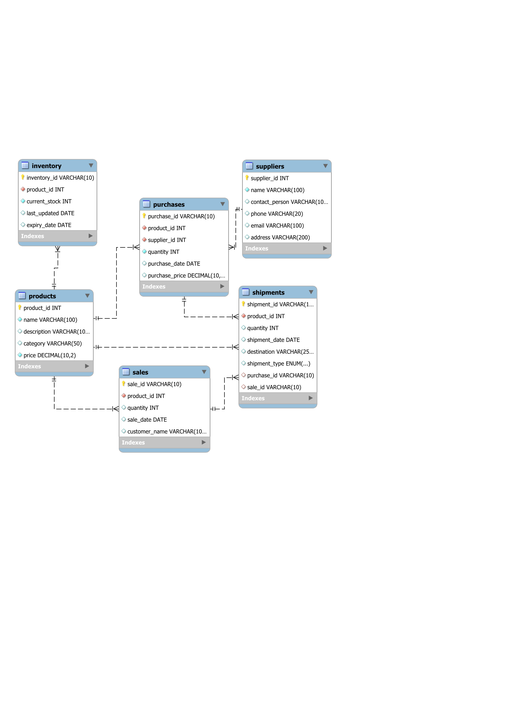
05 Entity Relationship Diagram
Notes:
A Product is created and listed in the Products table which is the central table and is Connected to Inventory, Purchases, Sales, and Shipments via product_id.
Inventory table tracks how much stock is available for that product, including expiry details.
Suppliers helps assess vendor performance, costs, and reliability of the Product through foreign key linked to product id .
When a purchase is made, an entry is added to the Purchases table, linking the Products and the Suppliers table through foreign key.
As the product is sold, entries are recorded in the Sales table which is linked to Products through foreign key productid.
Shipping details for both incoming (from supplier) and outgoing (to customer) are tracked in Shipments. Shipments connects both Purchases and Sales for movement tracking.
All the entities have one to many relationship.

Slide 8
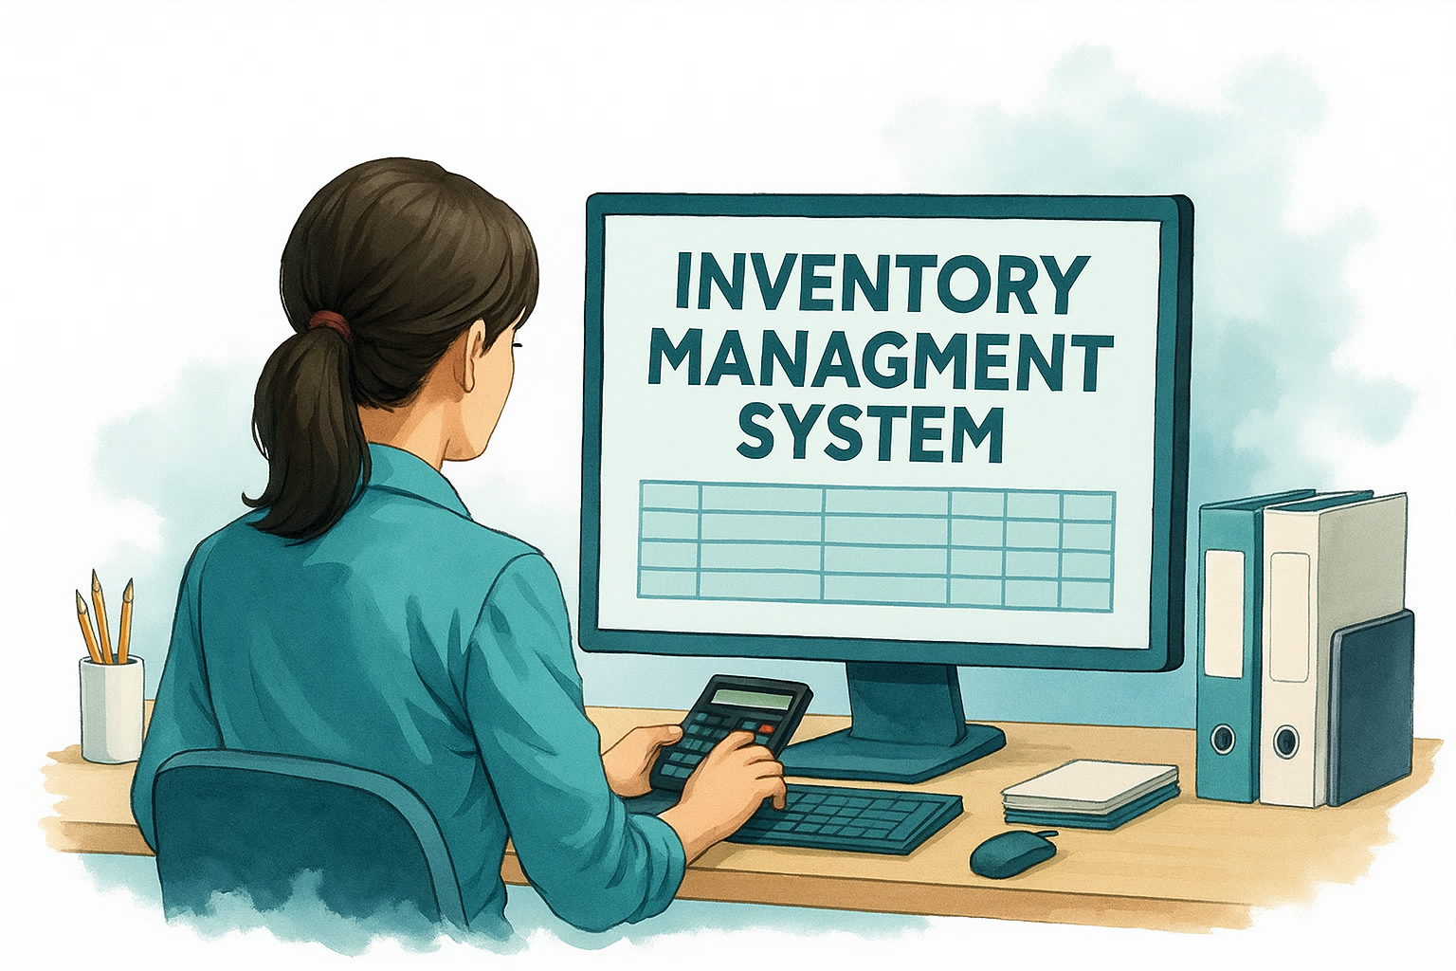
06 SQL Concepts Applied
Advanced Concepts
DDL Commands
Subquery
CREATE
ALTER
Joins
TRUNCATE
INNER JOIN
LEFT JOIN
DML Commands
INSERT
UPDATE
SQL Functions
SQL Concepts and Commands
DELETE
SUM()
DQL Commands
COUNT()
AVG()
SELECT
ROUND()
DATEDIFF()
Constraints
Operators
PRIMARY KEY
Comparison Operators
SQL Clauses
FOREIGN KEY
CASE
WHERE
NOT NULL
BETWEEN
GROUP BY
CHECK
HAVING
UNIQUE
ORDER BY
DISTINCT
LIMIT
Notes:
To run an effective analysis we have used a variety of SQL concepts like DDL, DML, DQL commands along with constraints, clauses, various operators, sql functions such as aggregate function, math functions, and date function. We have also used Joins and Subquery These allowed us to derive complex insights from raw data.

Slide 9

07 Inventory Management System Analysis
SECTION A: INVENTORY MANAGEMENT & OPERATIONS
SECTION B: PROCUREMENT & SUPPLIER PERFORMANCE
SECTION G: KEY PERFORMANCE INDICATOR
SECTION F: ADVANCED ANALYSIS & STRATEGY
SECTION C: SALES VS INVENTORY DYNAMICS
SECTION D: SHIPMENT TRENDS
SECTION E: FORECASTING INSIGHTS
Notes:
Let’s move into the core analysis, divided into seven sections, starting with inventory operations and moving toward advanced strategy and KPIs.

Slide 10

7.1
SECTION A: INVENTORY MANAGEMENT & OPERATIONS

Slide 11
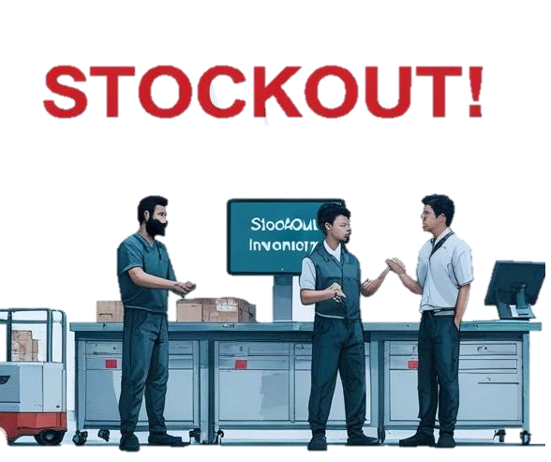
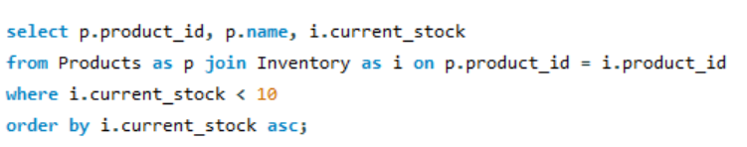
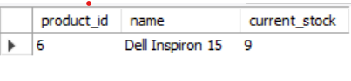
How many products are currently below critical level 10, indicating potential stockouts?
Insight: Dell Inspiron 15 needs to be restocked as it is running below critical level 10 to avoid customer dissatisfaction
Notes:
This question helps to identify products at risk of becoming unavailable due to low inventory levels.
It also helps prevent stockouts which can lead to missed sales, customer dissatisfaction, and disruption in supply chain operations.
Query: I have used joins to connect products and inventory table and used comparison operation to find the stock level below 10 which is assumed value.
The insight we get here is that the Dell Inspiron 15 needs to be restocked as it is running below critical level 10 to avoid customer dissatisfaction.

Slide 12
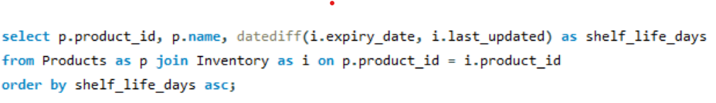

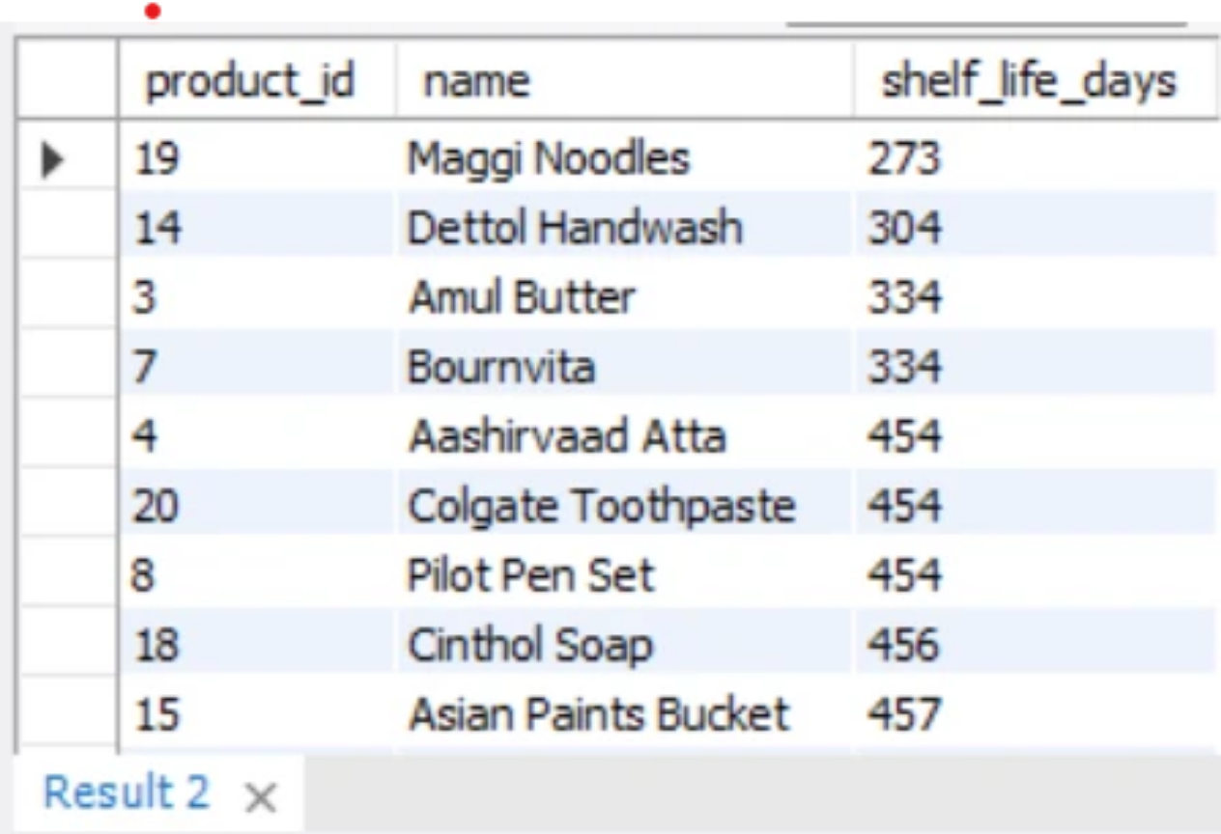
What is the shelf life (expiry - last updated) for products currently in Inventory?
Insight: Low shelf life product such as Maggi Noodles should be managed first as they are perishable items and plan their clearance.
Notes:
This question focuses on Product Shelf Life Monitoring and Expiry Risk Management.
Query – used datediff function to find the days between expiry date and last updated date from inventory table giving as shelf life
The insights we get is that the perishable items such as Maggi Noodles must be cleared first due to shorter shelf life to reduce risk of expiry and product wastage.

Slide 13


7.2
SECTION B: PROCUREMENT & SUPPLIER PERFORMANCE
Notes:
This section focuses on evaluating how well the procurement process and suppliers are performing

Slide 14

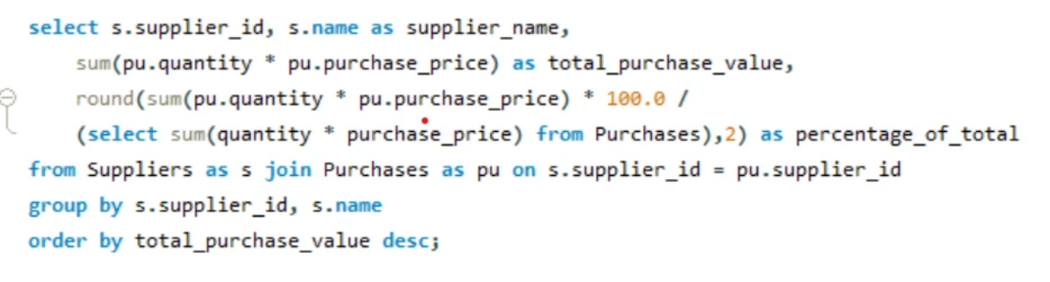
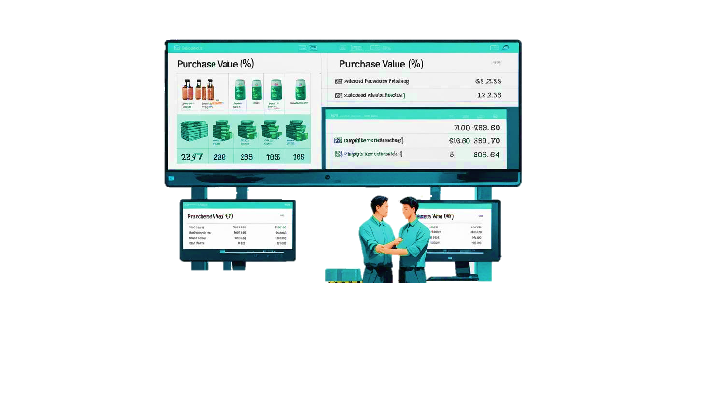
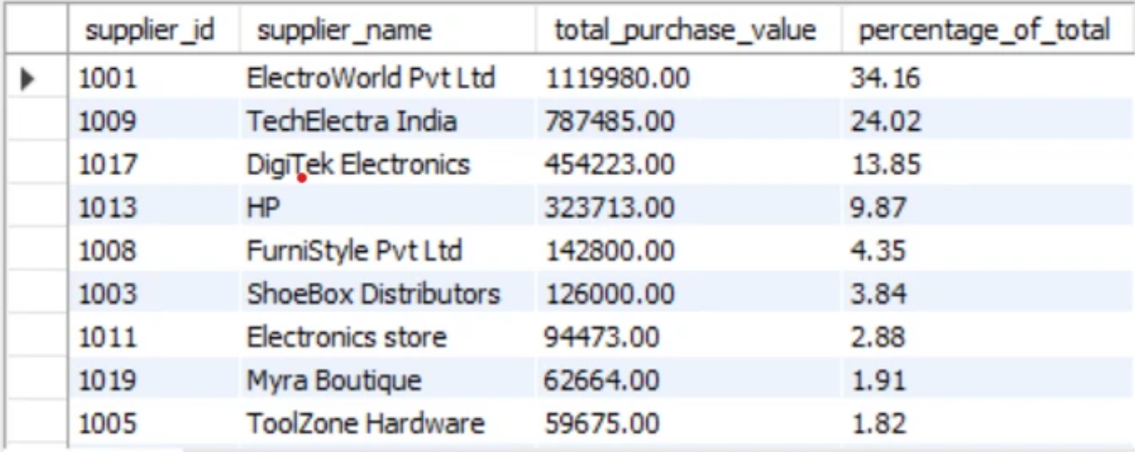
What is the total purchase value for each supplier, and what percentage of the overall procurement spend does each supplier represent?
Insight: A large percent of business is depended on ElectroWorld Pvt. Ltd.
Notes:
Here we Identify which are the top suppliers from where we procure more to understand who the business depends on most.
It also determines spend concentration, which can uncover risks.
Query- used sum function to calculate total purchase value for a product and then used same to calculate percentage by dividing with a subquery to find final purchase value for all products.
The insights that we get here is that A large percent of business is depended on ElectroWorld Pvt. Ltd which suggests negotiation with suppliers to reduce the risk of over investment.

Slide 15

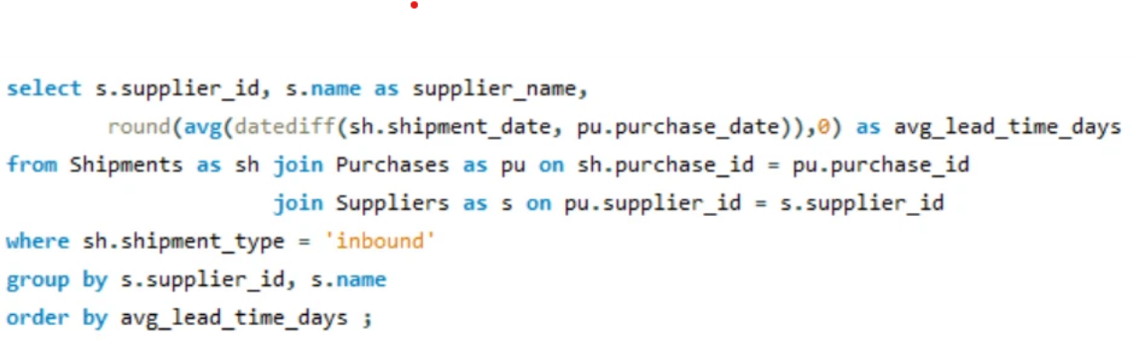

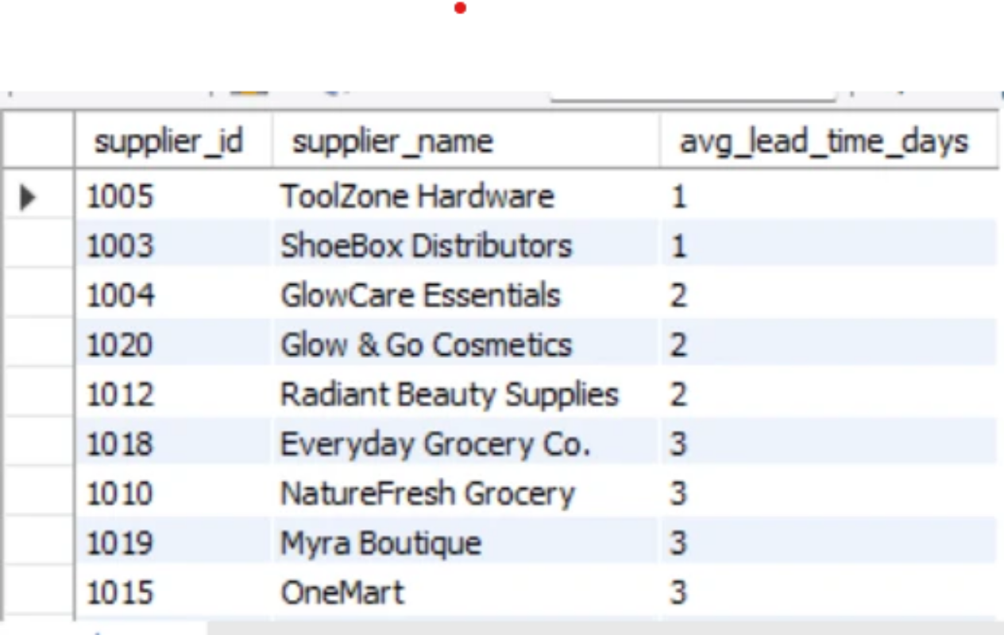
What is the average lead time (in days) from purchase date to inbound shipment receipt for each supplier?
Insight: Shorter avg days tell us how responsive the supplier is while longer avg
time may lead to stockouts
Notes:
This question focuses to calculate the average number of days it takes for each supplier to deliver products after an order is placed.
Helps assess how reliable and prompt suppliers are in fulfilling orders.
Query – used datediff function to find no. of days between shipment date from shipment table and purchase date from purchases table. Applying avg function and round function to round up the value for days.
Insights we get here is that toolzoon hardware take Shorter avg days which tell us how responsive the supplier is while longer avg time may lead to stockouts.

Slide 16


7.3
SECTION C: SALES VS INVENTORY DYNAMICS
Notes:
This section focuses on analyzing the relationship between product sales and inventory levels, which is essential for balancing supply and demand efficiently.

Slide 17
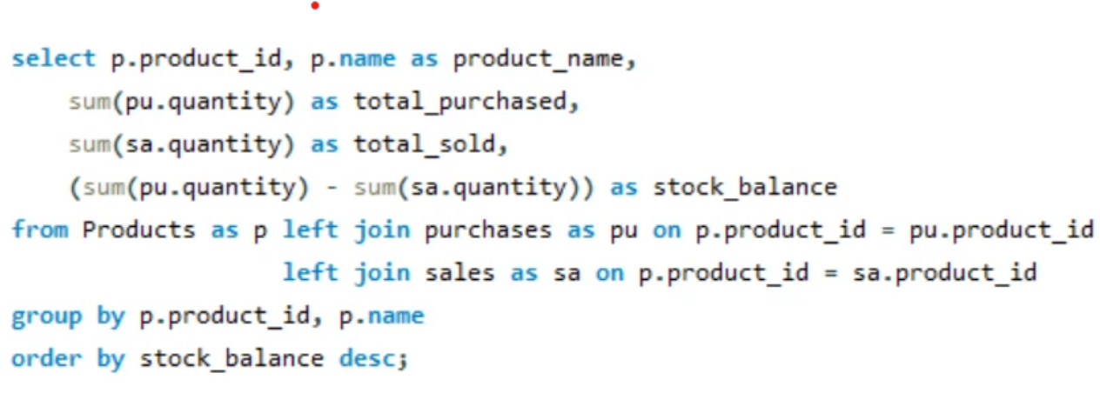
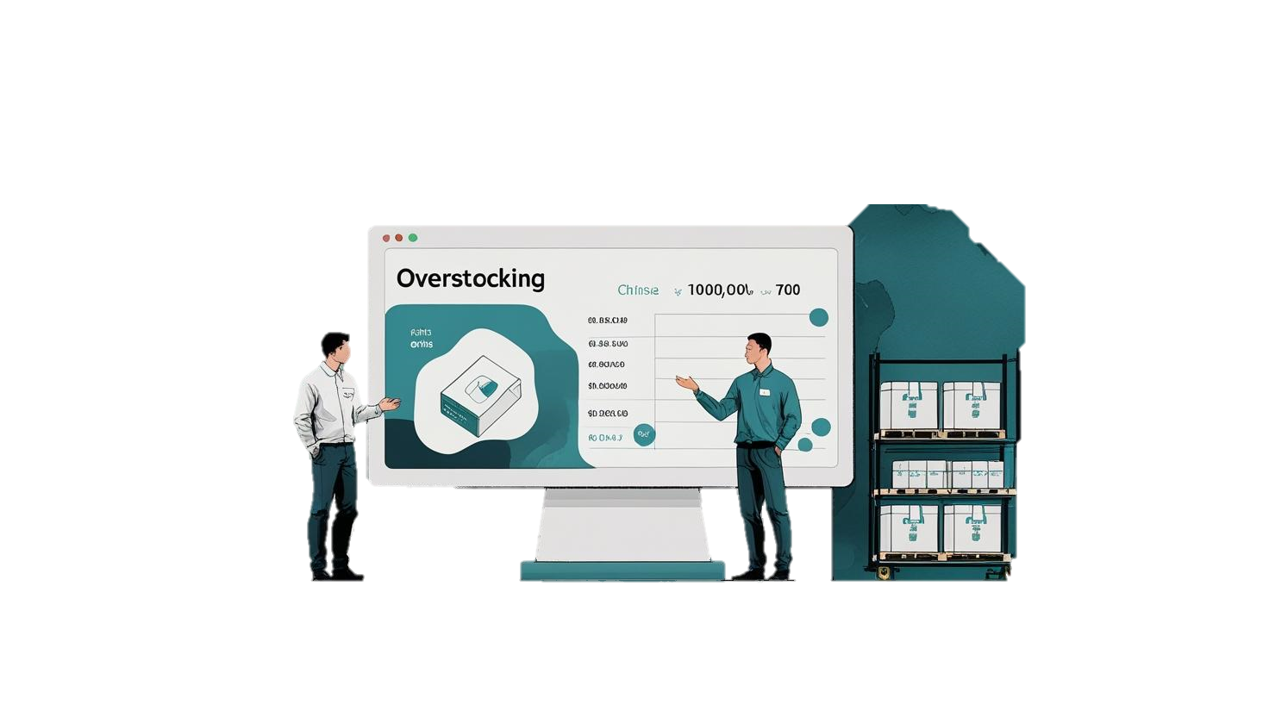
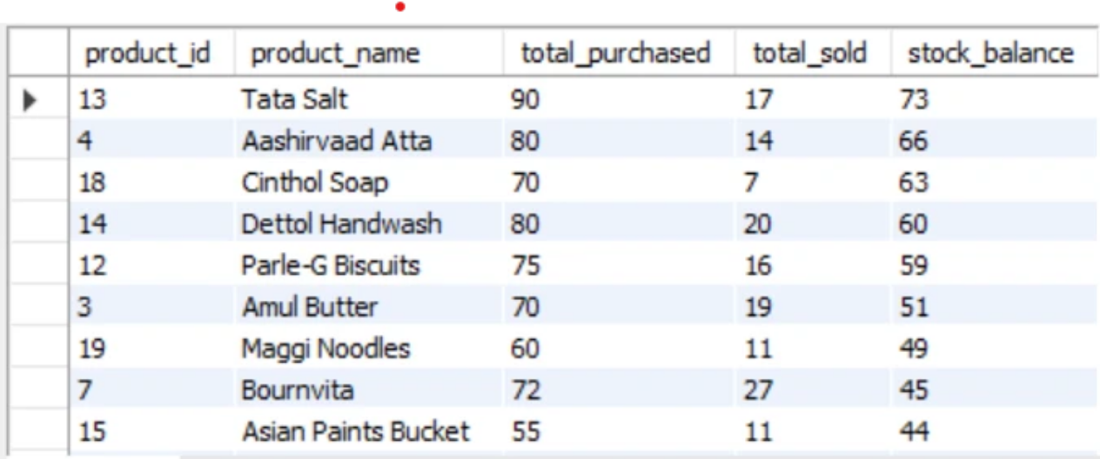
Compare the total quantity of products sold vs. quantity purchased. Are we overstocking or understocking?
Insights: As we can see that the total quantity purchased is consistently greater than total quantity sold, this indicates Overstocking
Notes:
This question focuses to determine whether:
More products are being purchased than sold (Overstocking), or
More products are being sold than purchased (Understocking)
Query – used sum with arithmetic operator (-) between quantity purchased and quantity sold giving as stock balance
Insights – we can clearly see that the stock balance is consistently high indicating overstocking suggesting stock clearance sales and discounts.

Slide 18


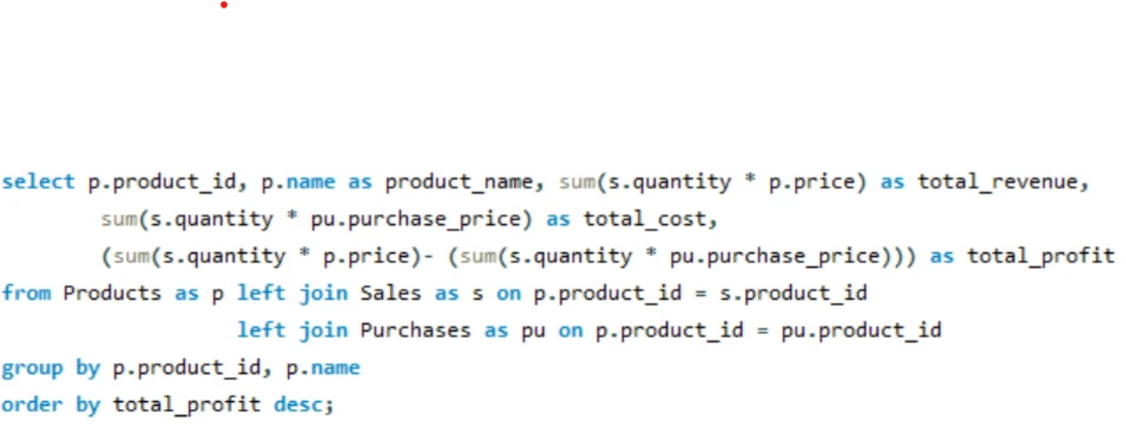
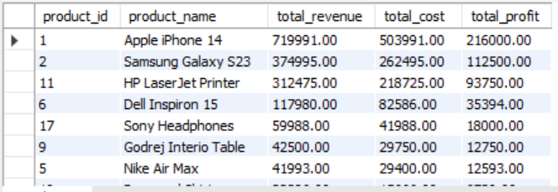
Which products are generating the highest and lowest profit, and how can this help optimize pricing or purchasing strategies?
Insight:
• iPhone 14 generates the most profit — ensure it's prominently marketed and never out of stock.
• Dettol Handwash sells well, but yields almost no profit — time to reassess pricing or supplier deals.
Notes:
The main objective of this question is To:
Identify the most profitable and least profitable products.
Use this information to adjust pricing, negotiate with suppliers, or discontinue low-margin items.
Query – calculated total revenue from sales quantity * product price and total cost from sales quantity * Purchase Price. Then differentiated both by using arithmetic operator(-) this gives us total profit.
Insights - • iPhone 14 generates the most profit which suggests to ensure it's prominently marketed and never out of stock.
• Dettol Handwash sells well, but yields almost no profit which suggest to reassess pricing or supplier deals.

Slide 19
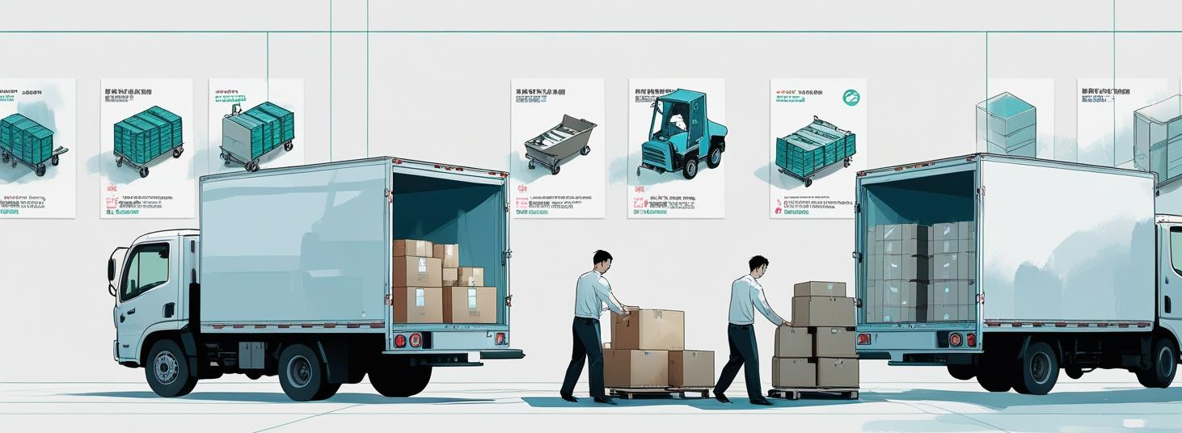
7.4
SECTION D: SHIPMENT TRENDS
Notes:
SHIPMENT TRENDS
focuses on analyzing patterns in inbound and outbound shipments over time to understand how inventory is moving through the supply chain.

Slide 20


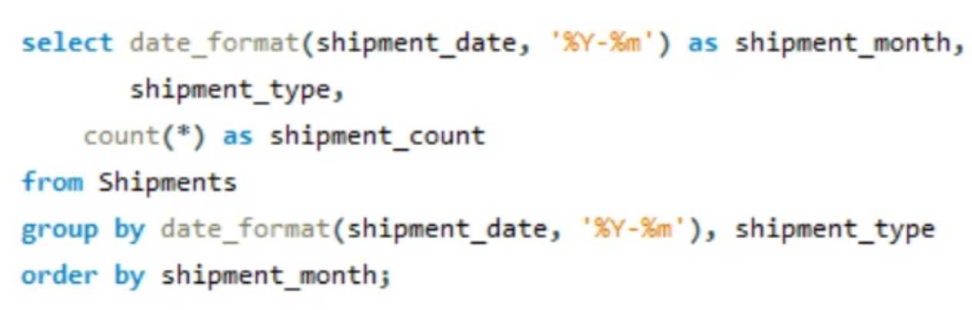
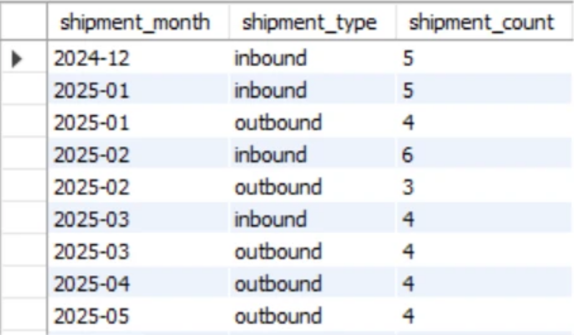
How many inbound vs. outbound shipments occurred month-wise, and what is the trend?
Insight: Outbound shipments spike at quarter start, suggesting planned restocking. No outbound shipments in 2024- Dec might point to low demand or late sales reporting.
Notes:
This question helps to Track
how active each month is in terms of supply chain movement.
Detect spikes or drops in shipments that could indicate:
Seasonal demand
Delays
Inventory buildup or depletion
Query – used date format function to extract from the shipment date using “%Y-%m” to display full year and month no. then grouping by shipment type to give shipment type count in that particular month.
Insight - Outbound shipments spike at quarter start, suggesting planned restocking. No outbound shipments in 2024- Dec might point to low demand.

Slide 21
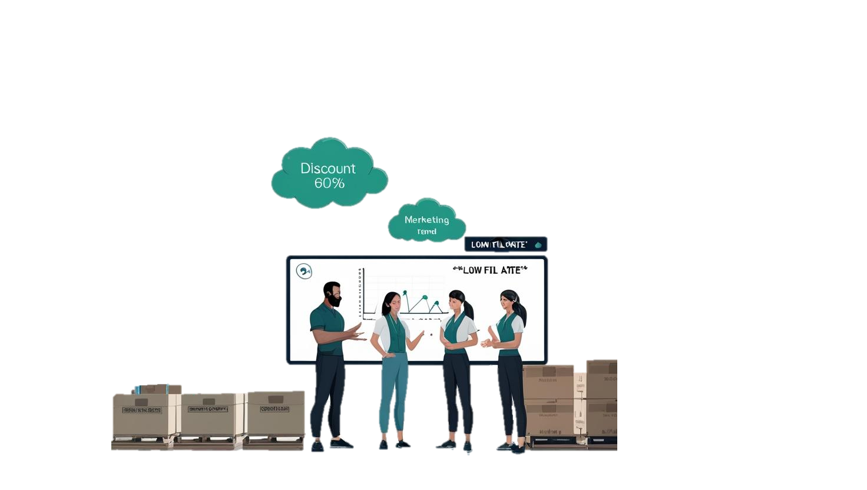
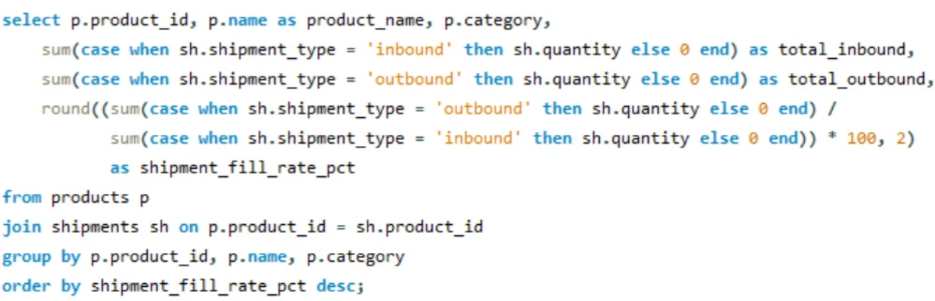
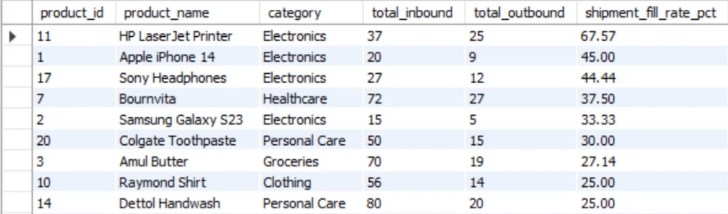
What is the shipment fill rate (%) per product and how does it vary across categories? What strategy should be used for low fill rate?
R
Insight: Products with high fill rates are aligned with customer demand; low fill rate products might need discounts, marketing, or stock reduction.
Notes:
This question focuses
To calculate the shipment fill rate for a product category i.e (how much of the ordered quantity was actually sold).
Query – here we have calculated
first total inbound by using case operator inside sum function to sum up only shipment quantities which are inbound shipment type.
Then total outbound was calculated in the similer manner but the shipment quantities were calculated with outbound shipments only
Found out shipment rate % by dividing total outbound with total inbound * 100 and using round() function to round the decimals upto to 2 places.
To group this result into categories I used group by function on category .
Insights – here Hp laser jet printer from electronics category has the maximum fill rate. i.e Products with high fill rates are aligned with customer demand; low fill rate products might need discounts, marketing, or stock reduction.

Slide 22
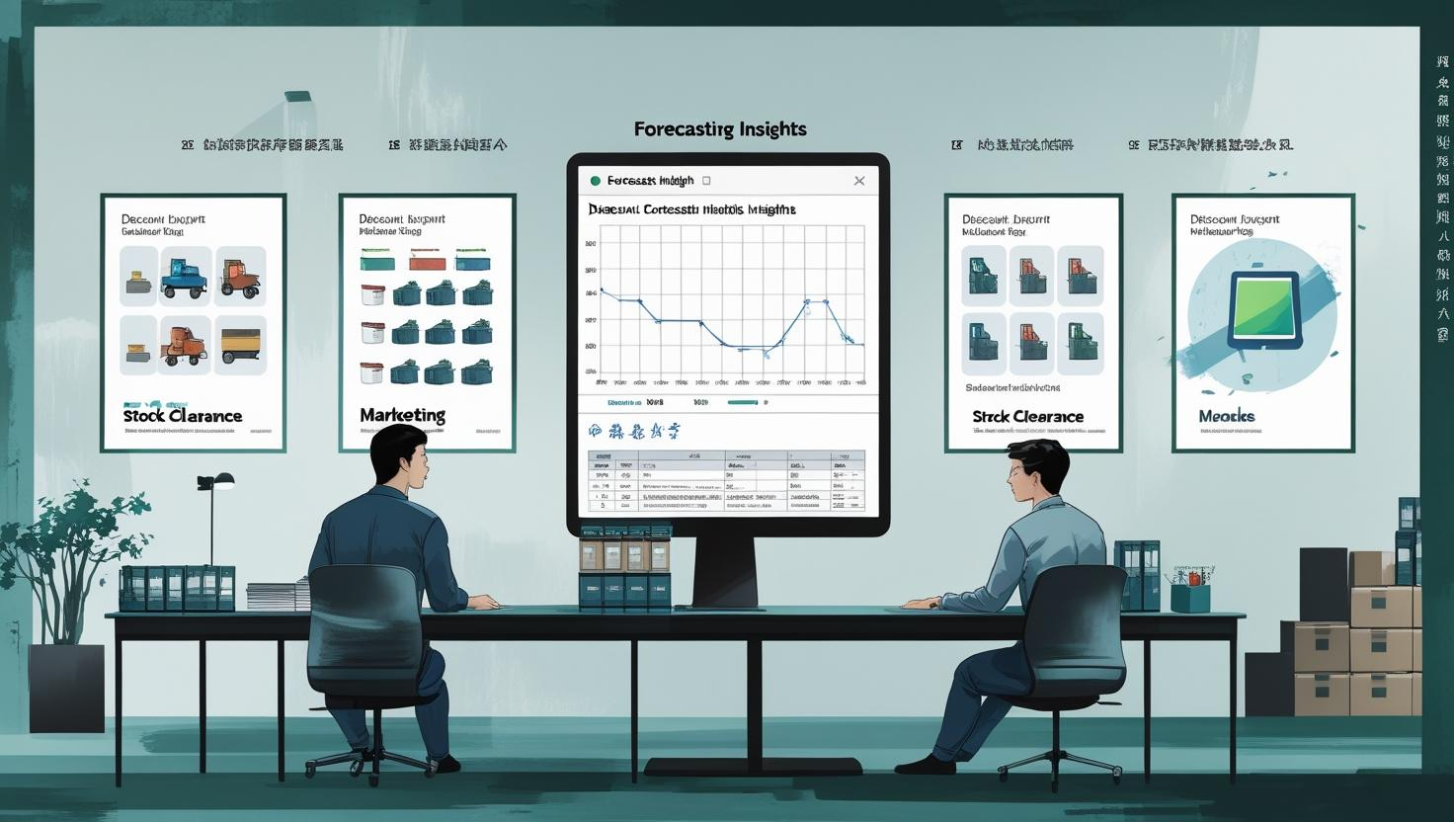
7.5
SECTION E: FORECASTING INSIGHTS
Notes:
This section focuses on using historical inventory, sales, and purchase data to predict future inventory behavior, particularly to prevent stockouts and maintain optimal stock levels.

Slide 23
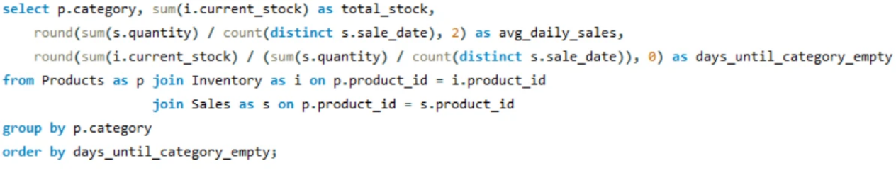
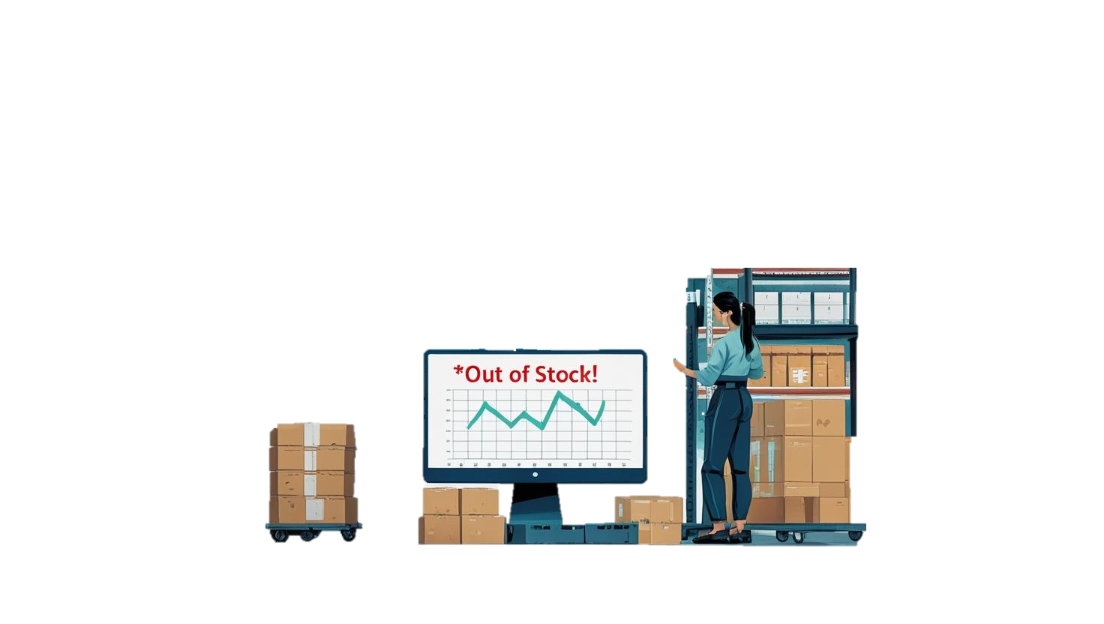
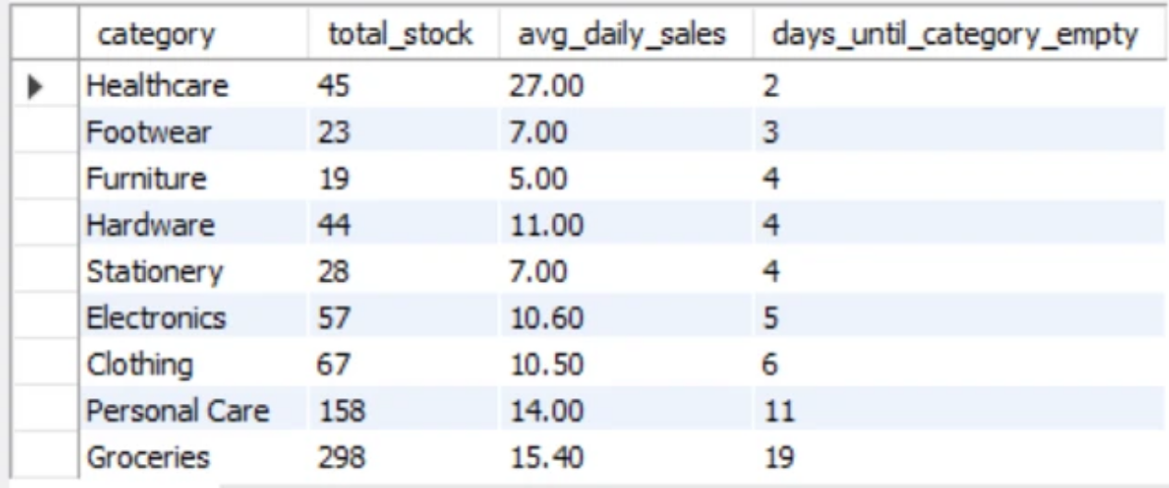
Based on past purchase and sales data, which products are likely to get out of stock?
Insight: Healthcare category may run out in next 2 days suggesting reorder.
Notes:
This question identify Stockout risk products by:
Calculating how long current stock will last based on recent sales trends.
Flagging items that may need urgent replenishment to avoid stockouts.
Query –
Calculated total stock from current stock of inventory table
Calculated average daily sales from sum of quantity from sales table divided by count of distinct sales date from sales date.
Then calculated days until category empty by dividing total stocks with avg daily sales
Group by category
Insights - Healthcare category may run out in next 2 days suggesting reorder.

Slide 24
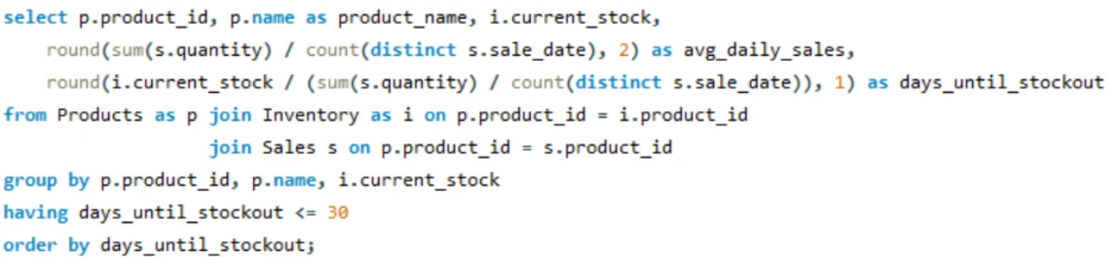
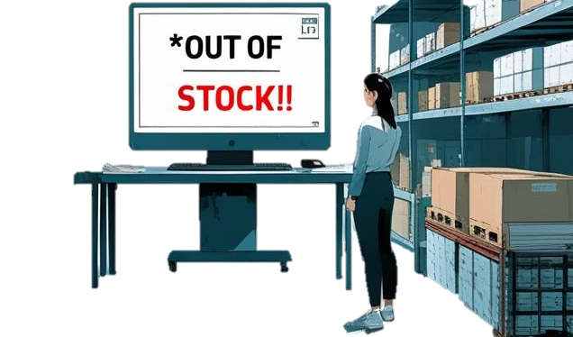
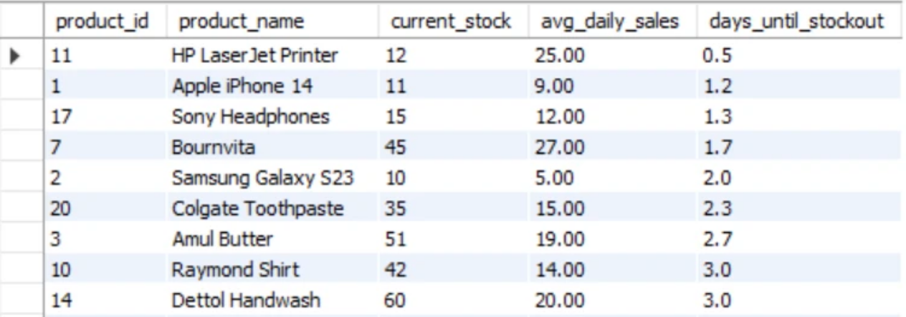
Predict which products may go out of stock in the next 30 days based on average daily sales.
Insight: HP laser jet printer has less than a day left for stock out suggesting reorder.
Notes:
His question focuses To forecast stock depletion of products over the next 30 days using recent sales data, so that businesses can:
Restock on time
Avoid stockouts
Reduce emergency or last-minute purchases
Query –
Calculated total stock from current stock of inventory table
Calculated average daily sales from sum of quantity from sales table divided by count of distinct sales date from sales date.
Then calculated days until category empty by dividing total stocks with avg daily sales
Group by category
Use having clause to filter groups with <= 30 days until stock out.
Insights- HP laser jet printer has less than a day left for stock out suggesting reorder.

Slide 25


7.6
SECTION F: ADVANCED ANALYSIS & STRATEGY
Notes:
This section dives deeper into data-driven decision-making using advanced SQL analysis. It goes beyond basic inventory tracking to identify inefficiencies, cost drivers, and strategic opportunities for optimization.

Slide 26
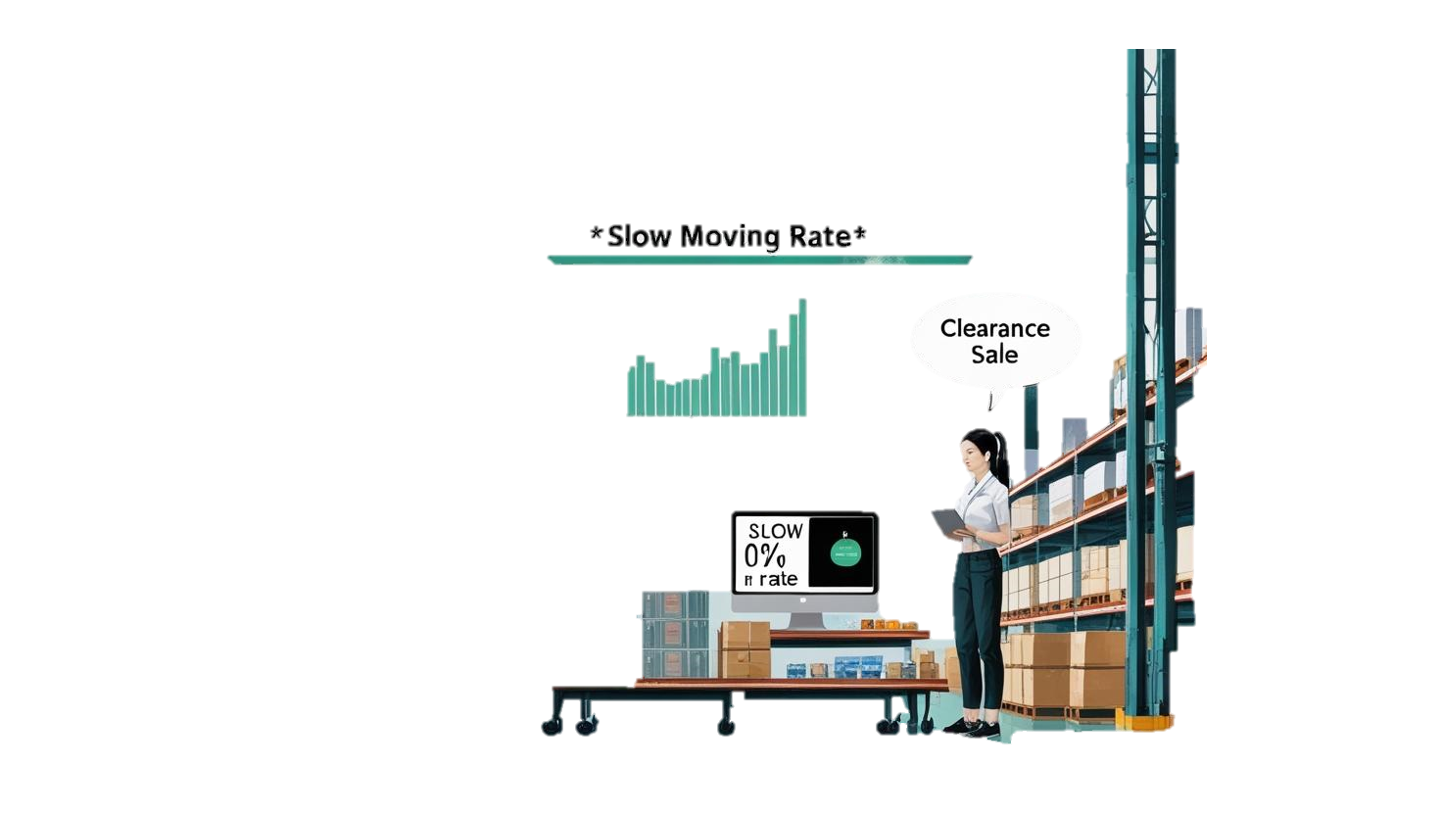
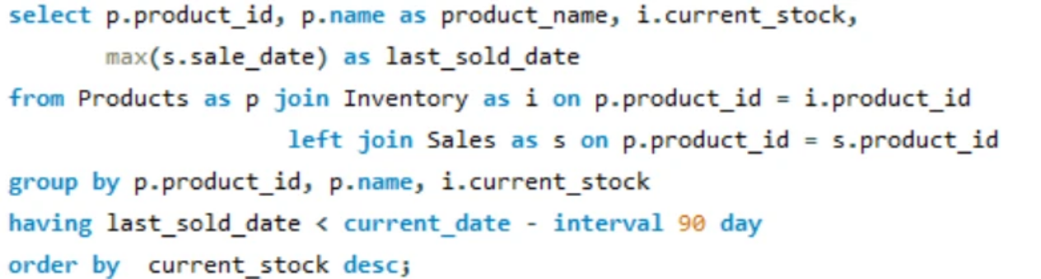
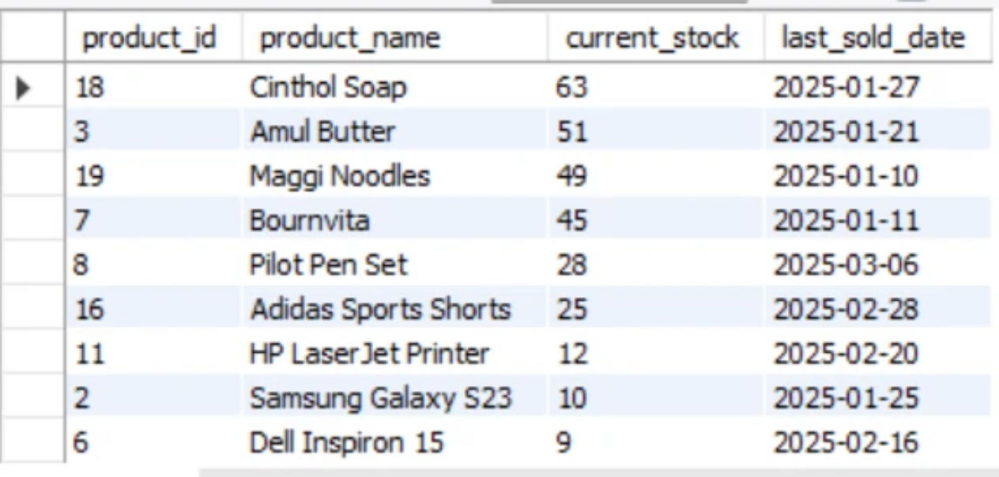
Identify slow-moving inventory (not sold in the last 90 days). What steps would you suggest to solve this?
Insight: Products with slow moving (high current_stock) can be put on clearance
sales by discounting them.
Notes:
This question objectifies To detect products that haven’t sold in the last 90 days, and then suggest actions to:
Free up warehouse space
Recover tied-up capital
Improve inventory efficiency
Queries-
Used max() aggregate function on sales date from sales table to calculate last sold date
Apply group by on product name and current stock
Use having to filter groups based on condition that last sold date should be lesser than 90 days(current days- interval of 90days)
Insghts- Here we can see that cinthol soap has high current stock. Products with slow moving (high current_stock) can be put on clearance sales by discounting them

Slide 27
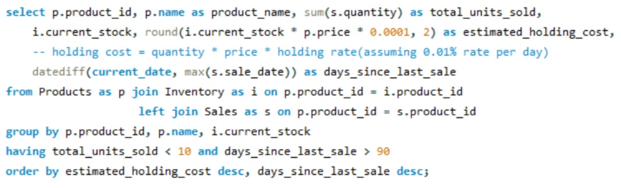
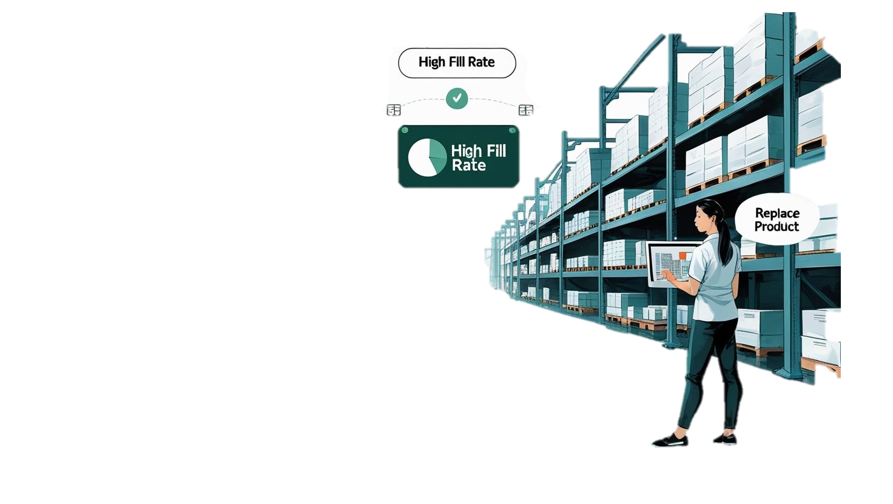
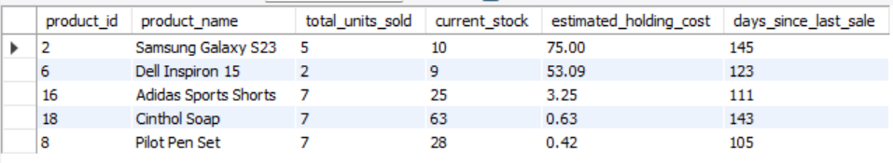
Which products should be discontinued or replaced due to consistently low sales and high holding costs?
Insight:
• Low sales volume indicates weak demand or poor market fit.
• Holding cost of 75 over 90 days - For a low-turnover product, that’s a relatively high cost.
• Last sale was 148 days ago - signals slowing movement.
• Suggests discount and replacement.
Notes:
This question is aimed at identifying non-performing inventory — products that consume resources but contribute very little to revenue or profit — and taking action to optimize inventory profitability.
Query-
Holding cost calculated by the formula = current stock from inventory table * Price from Products table * holding rate of o.ooo1(which is assumed o.o1% rate per day)
Used date diff to calculate the days between current date and last sales date by using max function
Group by and apply having clause to filter groups based on 2 condition
Total units sold < 10
Days since last sold >90
Insights-
Samsung galaxy s23 has a very high holding cost suggesting discount or replacement.

Slide 28

7.7
SECTION G: KEY PERFORMANCE INDICATORS
Notes:
This section focuses on measuring the overall performance of the inventory system using key metrics that reflect financial health, operational efficiency, and service levels.

Slide 29
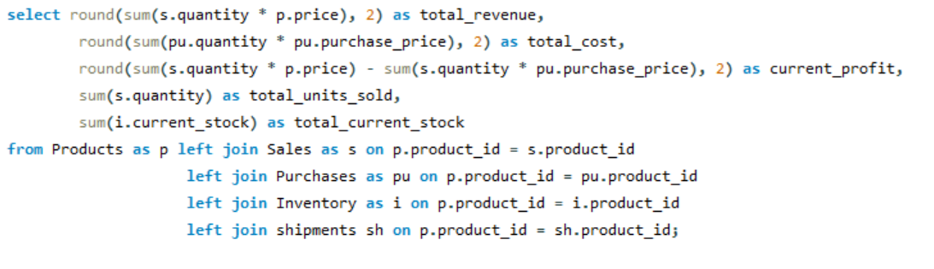
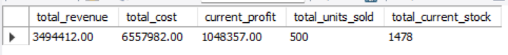
What is the overall performance of the inventory system in terms of revenue, cost, current profit, units sold, and stock availability across all products?
Notes:
Calculated total revenue till date
Total cost( purchase price)
Current profit
Total units sold till date
Total current stocks left
Insights - Gives a snapshot of inventory health
Helps assess whether the inventory is cost-efficient and profitable
Identifies areas for cost control or profit improvement
Supports reporting for management or stakeholders

Slide 30

8.
Conclusion and Strategy
Fix Stock Imbalances
Balancing stock levels to meet demand
Monitor Expiry Proactively
Tracking and managing product expiration dates
Adjust Supplier Contracts
Negotiating and modifying supplier agreements
Reduce Reorder Frequency
Decreasing the frequency of reordering slow-moving items
Discontinue Underperforming Items
Removing products with poor sales performance
Improve Pricing Strategies
Optimizing pricing for low-profit products
Notes:
To conclude, SQL analysis helped us uncover inefficiencies and define clear strategies such as:
fix stock balance to meet demands to avoid overstocking
Monitor expiry to manage product expiration and low shelf life to avoid wastage and loss of revenue.
Adjust supplier contract and negotiate to optimize purchase price
Reduce reorder frequency for slow moving items
Discontinue underperforming items with poor sales and giving less profit
Improve pricing strategy for low profit product.
By following all this strategies we can achieve a profitable business in inventory.

Slide 31




